Slide 1


Data Products

Slide 2
What Comes to Mind?
The next bus will arrive in 10 minutes
The price of a hotel reservation for next week is $97.

Slide 3
The Age of the Data Product
The information revolution - driven as it is by networked communication systems and the Internet, is unique in that it has created a surplus of a valuable new material — data — and transformed us all into both consumers and producers.
The sheer amount of data being generated is tremendous. Data increasingly affects every aspect of our lives.
We have developed a reasonable expectation for products and services that are highly personalized and finely tuned to our needs, creating a market for a new information technology — the data product.
https://www.oreilly.com/library/view/data-analytics-with/9781491913734/ch01.html

Slide 4
What is Data Product?
Data science is about insights (not information, not technology)
The best insights are actionable.
Data products are products that derive substantial value from analytics and whose primary objective is to use data to facilitate an end goal.
  Information product: Google Analytics
  Data product: Google Search
Data products are the reason data scientists are lately treated like rock stars.
Notes:
Information Product. ... It's any product or service that you can sell to people to provide them with information, usually about a specific topic.
A knowledge product is a result of human thought that has value.

Slide 5

“The future belongs to the companies and people that turn data into products.” -- Mike Loukides, O’Reilly

Slide 6
Notice the Different!
Information Product - It's any product or service that you can sell to people to provide them with information, usually about a specific topic.
  e.g. Instruction manual, news service and online directory.
A knowledge product is a result of human thought that has value.
  e.g. Lesson learned report, a summary of best practices, thesis and journal articles.

Slide 7
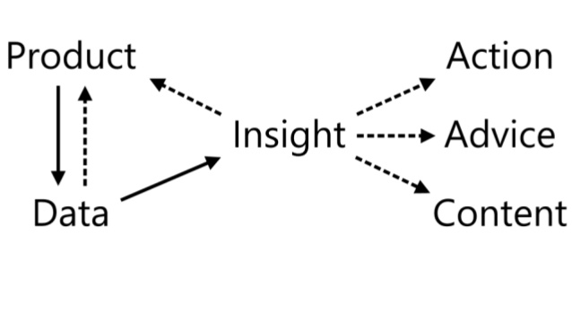
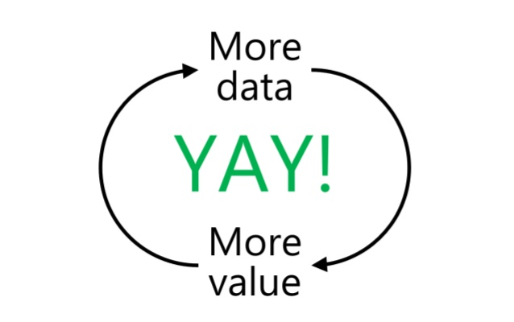
Data products are created with data science workflows, specifically through the application of models, usually predictive or inferential, to a domain-specific dataset.
A data product is an economic engine. It derives value from data and then produces more data, more value, in return.

Slide 8
3 TYPES OF DATA PRODUCTS

Slide 9
(i) Data as a Service
In this case, data itself is the product.
These products are offered to users as either a paid for or free service.
All data products that create direct revenue fall into this category.
Companies offering this type of data product provide data for specific interests such as to-the-second accurate stock-market data or location-specific weather data.
e.g. AcuWeather, Gro Intelligence

Slide 10
(ii) Data-Enhanced Products
These are data-based additional functions which modify a traditional product to increase its value
Data products which enhance a physical or virtual product fall into this second category.
The value of such a product is reflected in the change in revenue (price or quantity) of the enhanced product.
Most recommenders fall in this category, as they improve the sales of products.
  35% of Amazon’s revenue comes from recommendations - and why 75% of Netflix content is consumed based on recommendations.

Slide 11
(iii) Data as Insights
These are products that analyze data to provide insights to decision maker within an organization.
e.g. Google Analytics, Tableau, Cloudera / Hortonworks / MapR
Insights as a Service is a software service that specifically delivers quality, actionable insights. Typically, such services are hosted in the cloud.

Slide 12
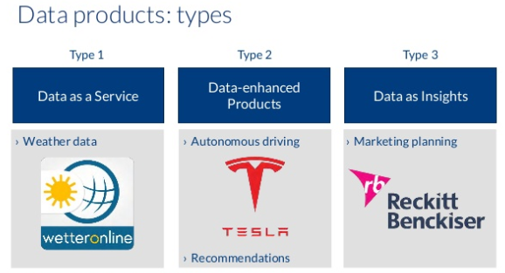

Slide 13
An Example of Data Product based on Predictive Modeling
Recommender systems
A subclass of information filtering systems that are meant to predict the preferences or ratings that a user would give to a product. Recommender systems are widely used in movies, news, research articles, products, social tags, music, etc.
Amazon recommender system
Amazon examines items customers have purchased, and based on similar purchase behavior of other users, makes recommendations. In this case, order history data is combined with recommendation algorithms to make predictions about what customer might purchase in the future.

Slide 14
Recommendation Engines
Recommendation engines filter out the products that a particular customer would be interested in or would buy based on his or her previous buying history.
The more data available about a customer the more accurate the recommendations.

Slide 15
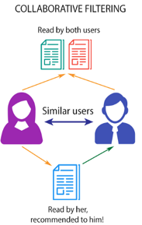
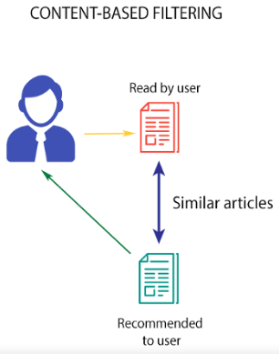
Types of Recommender Systems
The TWO main types of recommender systems are:

Slide 16
Collaborative Filtering
A method of making automatic predictions (filtering) about the interests of a user by collecting preferences or taste information from many users (collaborating).
Typically, the workflow of a collaborative filtering system is:
Look for users who share the same rating patterns with the active user (the user whom the prediction is for).
Use the ratings from those like-minded users found in step 1 to calculate a prediction for the active user.
Two types of collaborative filtering techniques are used:
User-based collaborative filtering
Item-based collaborative filtering
https://towardsdatascience.com/brief-on-recommender-systems-b86a1068a4dd

Slide 17
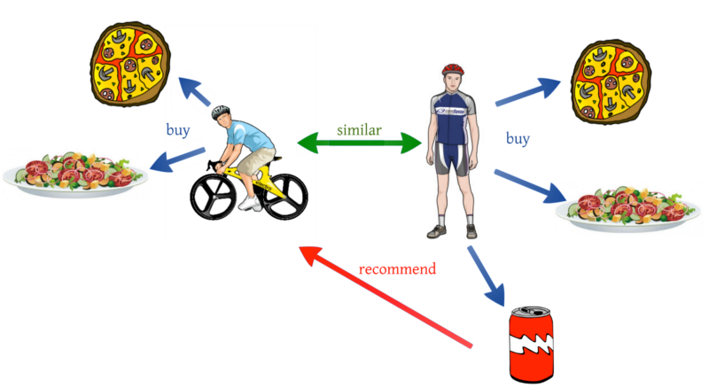
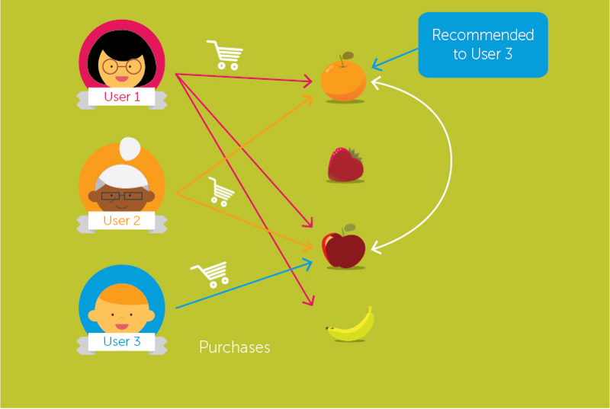
Two types of collaborative filtering techniques
User-based collaborative filtering
Item-based collaborative filtering

Slide 18
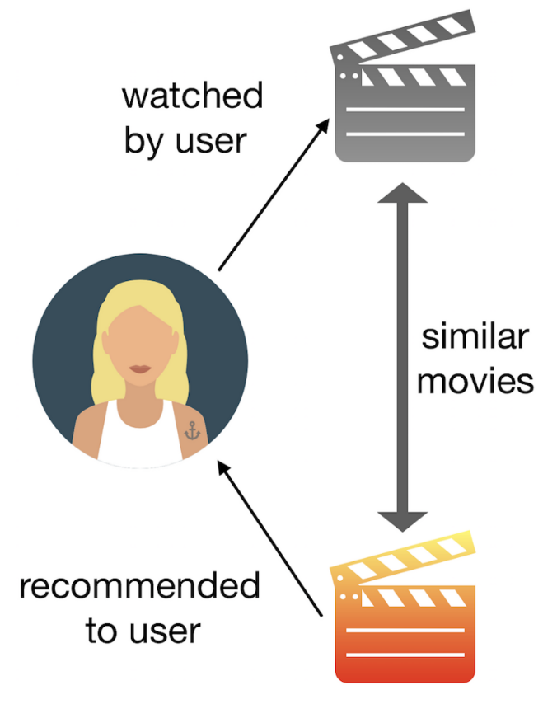
Content-based filtering
This filtering is based on the description or some data provided for that product.
The system finds the similarity between products based on its context or description. The user’s previous history is taken into account to find similar products the user may like..
If a user likes movies such as ‘Mission Impossible’ then we can recommend him the movies of ‘Tom Cruise’ or movies with the genre ‘Action’

Slide 19
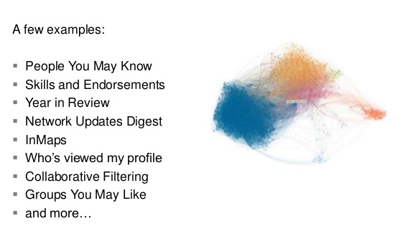
Building Products from Data at Linkedln

Slide 20
Active vs Passive Data
Active / explicit data – user needs to actively provide the data (e.g. User ratings and reviews).
Passive / implicit data – data collection in which data is gathered automatically often without user knowledge (e.g. user clicks and views).

Slide 21
Data Products Functions
FIVE broad groups of data products functions:
Raw data,
Derived data,
Algorithms,
Decision support and
Automated decision-making
https://towardsdatascience.com/designing-data-products-b6b93edf3d23

Slide 22
(1) Raw Data
Starting with raw data, we are collecting and making available data as it is (perhaps we’re doing some small processing or cleansing steps).
The user can then choose to use the data as appropriate, but most of the work is done on the user’s side.
http://Gnip.com - the official reseller of Twitter's data(tweets)

Slide 23
(2) Derived Data
In providing users with derived data, we are doing some of the processing on our side.
In the case of customer data, add additional attributes like assigning a customer segment to each customer, or we could add their likelihood of clicking on an ad or of buying a product from a certain category.

Slide 24
Derived Data
A derived data element is a data element derived from other data elements using a mathematical, logical, or other type of transformation, e.g. arithmetic formula, composition, aggregation.

Slide 25
(3) Algorithms
Algorithms, or algorithms-as-a-service.
We are given some data, we run it through the algorithm - be that machine learning or otherwise - and we return information or insights.
A good example is Google Image: the user uploads a picture, and receives a set of images that are the same or similar to the one uploaded.
Behind the scenes, the product extracts features, classifies the image and matches it to stored images, returning the ones that are most similar.

Slide 26
(4) Decision Support
Providing information to the user to help them with decision-making but we are not taking the decision ourselves.
Analytics dashboards such as Google Analytics, Flurry, or WGSN would fall into this category.
Give the user relevant information in an easy-to-digest format to allow them to take better decisions.
In the case of Google Analytics, that could mean changing the editorial strategy, addressing leaks in the conversion funnel, or doubling down on a given product strategy.
The important thing to remember here is as follows: while we have taken design-decisions in data collection, derivation of new data, in choosing what data to display and how to display it, the user is still tasked with interpreting the data themselves. They are in control of the decision to act (or not act) on that data.

Slide 27
(5) Automated Decision-Making
Here we outsource all of the intelligence within a given domain.
Netflix product recommendations or Spotify’s Discover Weekly would be common examples.
Self-driving cars or automated drones are more physical manifestations of this closed decision-loop.
We allow the algorithm to do the work and present the user with the final output (sometimes with an explanation as to why the AI chose that option, other times completely opaque).

Slide 28
Generally speaking these product types are listed in terms of increasing complexity. More specifically, they are listed in terms of increasing internal complexity and (should have) less complexity on the user’s side.
The more computation, decision-making or “thinking” the data product does itself, the less thinking required by the user.

Slide 29
Typically raw data, derived data and algorithms have technical users.
Most often they tend to be internal products in an organization but counter-examples would include Ad Exchanges, or API suites.
Decision support and automated decision-making products tend to have a more balanced mix of technical and non-technical users.

Slide 30
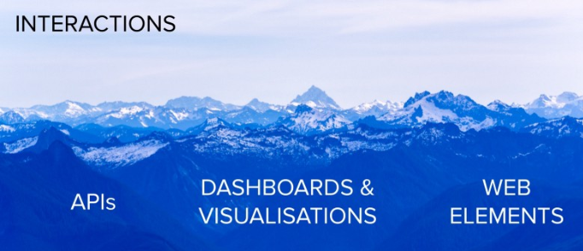
Data Interactions
Each of these data products can be presented to our users in a variety of ways.
What are these interfaces or interactions?

Slide 31
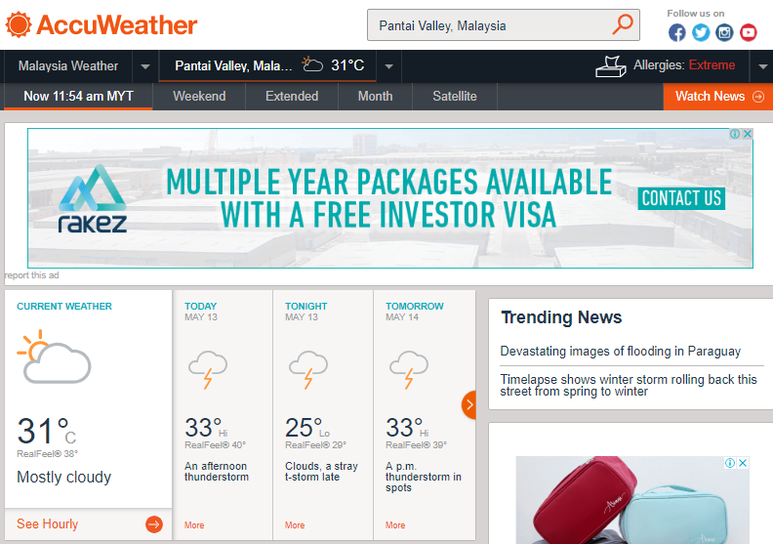
API
APIs are the de-facto standard for building and connecting modern applications.
AccuWeather,* via its self-service portal, offers both an API product with up-to-the-minute weather data and an API product with daily weather data.
https://www.accuweather.com/en/my/pantai-valley/787644/weather-forecast/787644

Slide 32
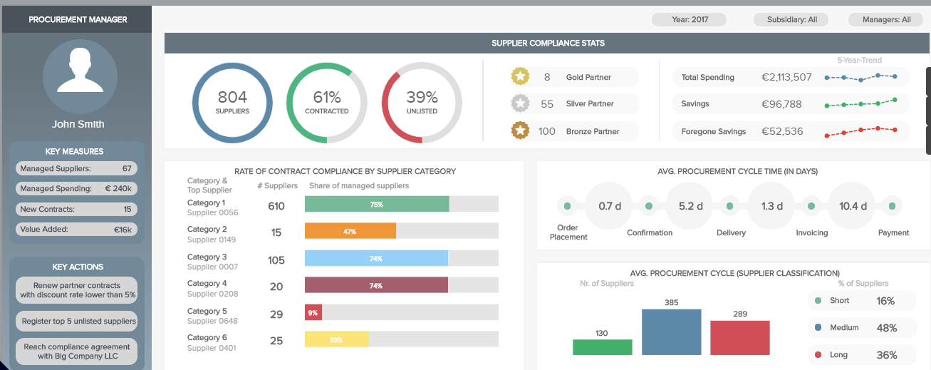
Dashboards & Visualizations
Dashboards are a data visualization tool that allow all users to understand the analytics that matter to their business.

Slide 33


Web Elements
More recently, these interfaces have been broadly extended to include voice, robotics and augmented reality, amongst others.

Slide 34
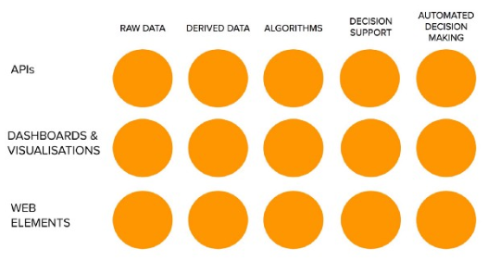
Data Product Matrix
Different products require different approaches

Slide 35
Art of Data Science
Data science builds models that work on large datasets, from thereon one makes predictions.
The art of data science is to figure out which feature to use when.
If you look at datasets, it is rows of data stored in the table, every column is called a feature and the model that we build needs to shortlist the features.
Based on the features, one makes predictions and shortlisting of features is called feature selection.
https://www.analyticsindiamag.com/data-enabled-products-defining-future-data-science/

Slide 36
Feature Engineering
Feature engineering is the process of using domain knowledge of the data to create features that make machine learning algorithms work.
THREE main tasks in feature engineering:-
Feature transformation
Feature generation
Feature selection

Slide 37
Feature Transformation
Constructing new features from existing features; this is often achieved using mathematical mappings.
For example, the BMI index is a feature obtained through feature transformation using a mathematic formula.

Slide 38
Feature Generation
Generating new features that are often not the result of feature transformation.
For example, one generates new usable features for images from the pixels of the images (as the pixels are not usable features).
Many domain specific ways for defining features also belong in the feature generation category.
Feature generation methods can be generic automatic ones, in addition to domain specific ones.
Patterns mined from given data can also be used to generate new features. Sometimes the terms ``feature extraction” and “feature construction” are used for feature generation.

Slide 39
Feature Selection
Selecting a small set of features from a very large pool of features. The reduced feature set size makes it computationally feasible to use certain machine learning and data analytic algorithms.
Feature selection may also lead to improved quality on the result of those algorithms.
Feature selection has traditionally been focused on the classification problem, but it is also needed for other data analytic problems.

Slide 40
Feature Selection
A dataset about customers
To find out: what product customers are most likely to buy.
Have to figure out - which features are important in making those decisions.
Might decide that age of customer is the feature to be included in the analysis, gender is a feature to be included but by some reason the post code they are residing is not a feature to be included this process.
This is called feature selection and once we have our features we build different types of models that fall into a couple of different types of categories.

Slide 41
Automatic feature engineering is about generic approaches for automatically generating a large number of features and selecting an effective subset of the generated features in the process.
Feature analysis and evaluation is about evaluating the usefulness of features and feature sets. This is sometimes included as part of feature selection.

Slide 42
Productization
Any successful data science project must end with productization.
This is the stage where trained models are deployed as application that can be easily accessed by the end users.

Slide 43
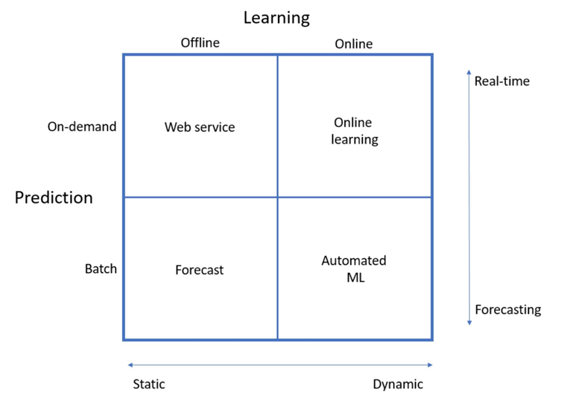
Productionalizing Machine Learning Models
FOUR different ways of productionalizing machine learning models.

Slide 44
Batch Prediction
The simplest form of machine learning workflow is the batch prediction.
This is typically seen in academia and places like Kaggle.
You take a static dataset, run your model on it, and output a forecast. How do you productionalize something like that?
On Kaggle, you save your predictions to a CSV file that you submit through an online form.

Slide 45
Web Service
The most common type of machine learning workflow is a simple web service.
The web service takes in some parameters and spits out a prediction straight away.
This is way more agile than the batch prediction scheme.
The difference from batch predictions, apart from running in near real-time, is that it handles a single record at a time, instead of processing all the data at once.

Slide 46
Online Learning
Emerging now is real-time streaming analytics, also known as hot path analytics.
This works very well with the lambda architecture that’s so popular in big data systems.
The input data in this case would be a stream of events, and the model would be placed right in the firehose, so to speak, running the model on the data as it enters the system.
The model would typically be running as a service on a Spark cluster or something similar. This is very useful for sensor data.

Slide 47
Automated ML
Tendency to think of machine learning models as something you train, deploy and forget, but that’s often not good enough.
Online learning means that your model learns, improves and updates itself while in production.
This obviously requires some engineering, but the payoff is a dynamic model.
An even more sophisticated version of this is automated machine learning. Instead of updating the model, you can run an entire machine learning pipeline online in production that comes up with entirely new models on the go.

Slide 48
Dataprenuers
The entrepreneurs focused on data science and related topics like Business Intelligence, Business Analytics, Predictive Modeling, Machine learning etc.
The datapreneurs are classified in 4 areas:
  Data Products,
  Data Science Services,
  Data Science Training, and
  Data Science Communities
Examples for the 4 areas:
  Jim Goodnight & John Sall (SAS), Christian Chabot (Tableau)
  Gurjeet Singh (Ayasdi), Carlos Guestrin (Apple)
  Andrew Ng (Coursera), Sebastian Thrun (Udacity)
  Anthony Goldbloom (Kaggle), Gregory Piatetsky-Shapiro (Kdnuggets)
https://www.kdnuggets.com/2015/09/top-datapreneurs-data-science-analyticsvidhya.html

Slide 49
Try the Demo &
Watch the Video
https://demos.datasciencedojo.com/
Beyond Analytics — Building Data Products for Data Natives
https://databricks.com/session/beyond-analytics-building-data-products-for-data-natives (21 minutes)
So You Want to Build a Data Product? - http://on.wsj.com/1qbvL87
https://www.oreilly.com/library/view/data-analytics-with/9781491913734/ch01.html

